Slide 1
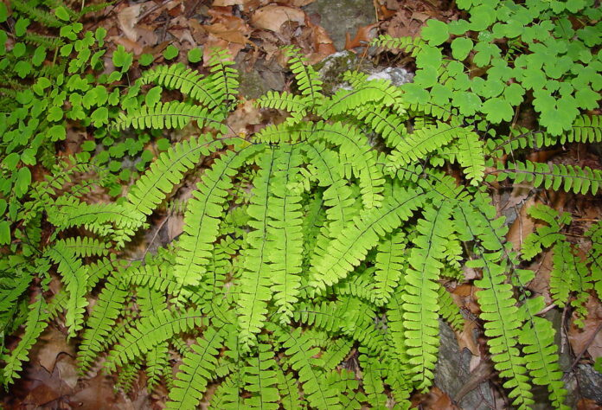
Adiantum
Dr. Jahid Ali Malik

Slide 2
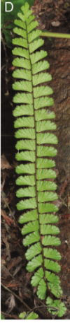
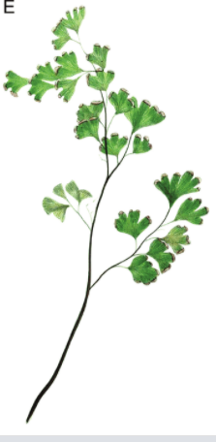
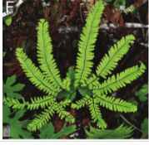
Adiantum is popularly called ‘Maiden hair fem’ because of the shiny black rachis of the leaves, which resemble with black hair of young ladies.
Also known as “Walking fern”.
There are nearly 200 species.

Slide 3
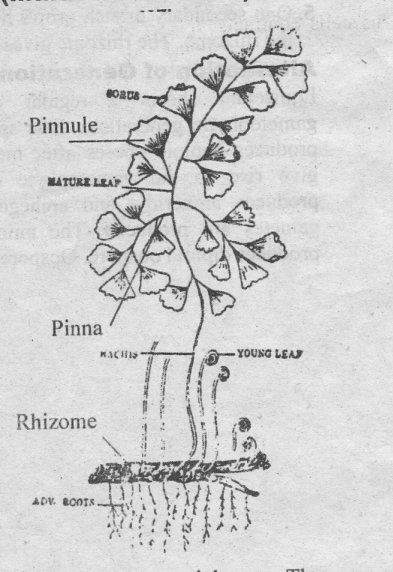
Sporophyte of Adiantum:
Morphology of the plant:
The sporophytic plant body consists of an under­ground rhizome from which are produced leaves and roots.
The rhizome is covered with chaffy scales (Paleae). It may be erect (A. caudatum), semi erect (A. pet- datum), or creeping (A.capillus-veneris).

Slide 4
Sporophyte of Adiantum:
From the undersurface of the rhizome arise a number of adventitious roots. The roots are stiff and black in colour. Occasionally they may be branched.
The leaves are produced in acropetalous succession on the creeping rhizome. They show circinate vernation typical of ferns.
The rachis of the leaf is hard, wiry, shiny and black or dark brown in colour thus giving the name maiden hair fern.

Slide 5
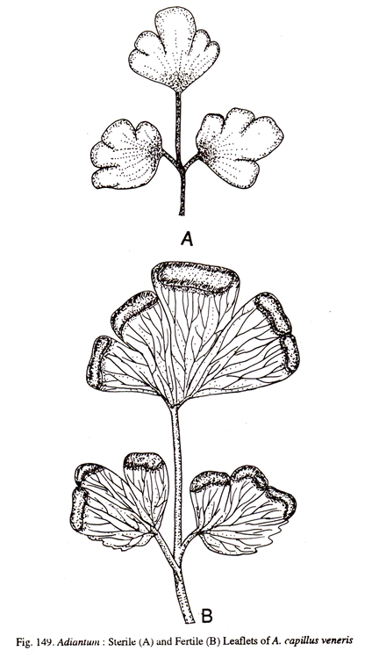
Sporophyte of Adiantum:
The leaves may be unipinnate or bi or tri-pinnate. The pinnae are stalked and have a dichotomous venation.
There is no distinction between fertile and sterile leaves in Adiantum.
Sori are borne on the ventral surface of the pinnae.

Slide 6
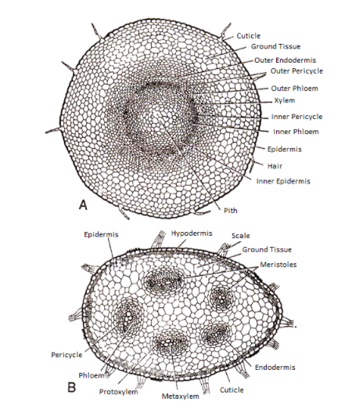
Rhizome: Amphiphloic solenostele

Slide 7
Rhizome: Dictyostele

Slide 8
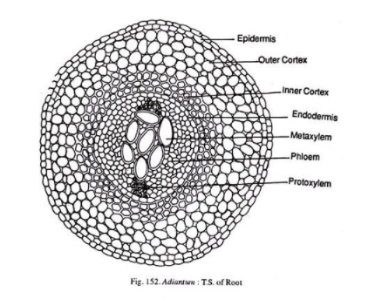

Slide 9
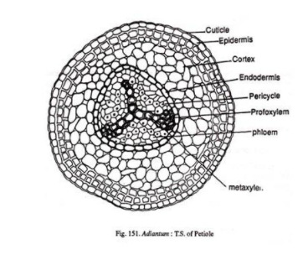

Slide 10
